Slide 1
DTS205TC High Performance Computing
Lecture 9 Dense Matrix Algorithms
Di Zhang, Spring 2024

Slide 2
*cheatsheet for system design
Event-driven, or batch processing?
  Former. -》Distributed systems, stream computing, etc
Can you predetermine the communication relationship between tasks?
  No. Multi-agent system, peer-to-peer system
Can the required speedup ratio be achieved in theory? (Is there enough concurrency?)
  No. uses other algorithms, or approximate algorithms, or hardware acceleration.
Do I have to use > 30 hardware threads (Maximum in experience) to meet the speedup ratio?
  No. -》openMP。
Task decomposition, or data decomposition?
  Task decomposition. You can simply use multi-process, Pthread, etc.
Under data decomposition, the amount of computation is unpredictable?
  Dynamic scheduling.
Can be predicted. Use static mapping:
  Grid, Graph decomposition

Slide 3
Section
Matrix multiplication

Slide 4
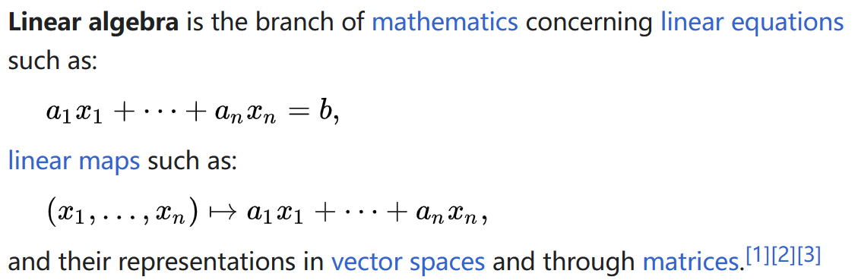
linear algebra
Linear algebra is central to almost all areas of mathematics.

Slide 5
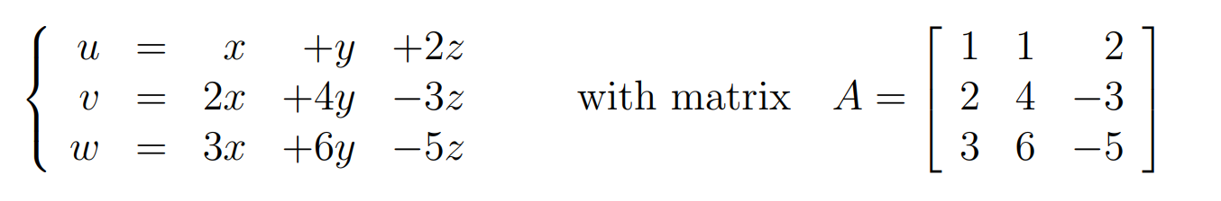
A system of linear equations
Abstraction:
  First level: we ignore the context of a specific problem and go straight to the system of equations
  Second level: we ignore variable naming and look directly at linear mappings. We found that the map itself can also do operations, for example: multiplication!

Slide 6
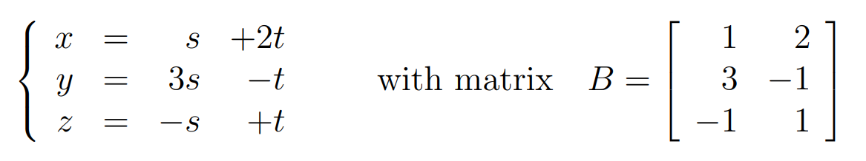
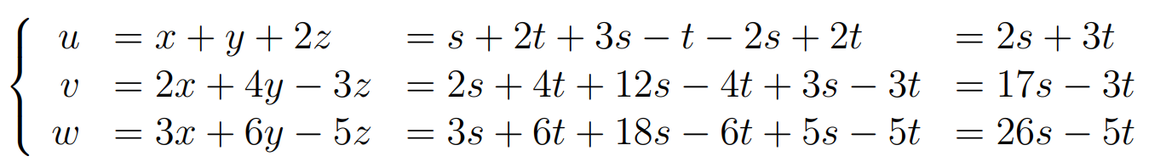
Matrix multiplication
we substitute in turn linear expressions for each of x, y, and z
We see that u, v, and w then become linear expressions in s and t
Notes:
linsub.pdf (jhu.edu)

Slide 7
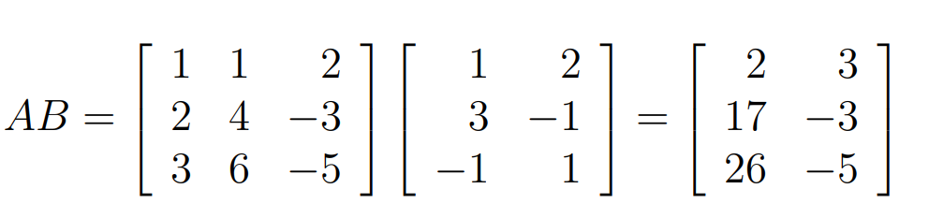
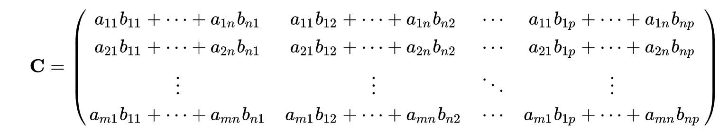
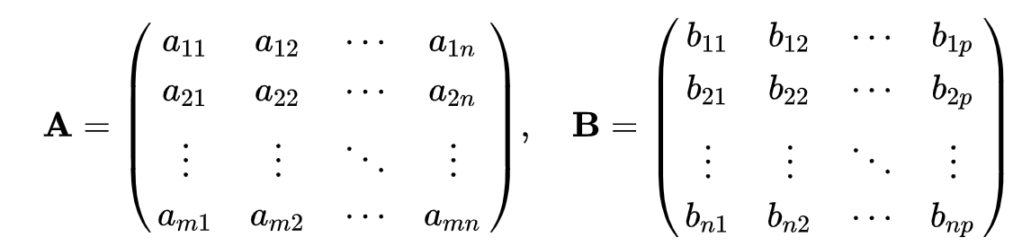
Matrix multiplication
From this example, we can define matrix multiplication

Slide 8
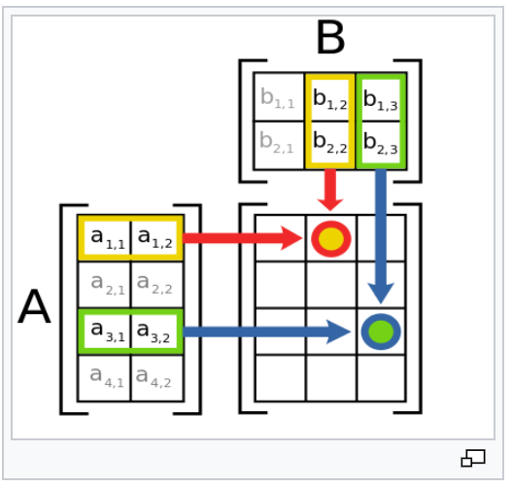
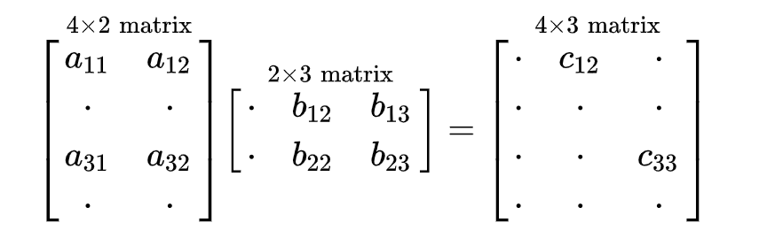




Matrix multiplication
Features of matrix multiplication:
  For multiplying matrices, their dimensions must match
  It satisfies the law of associativity and distribution, but not the commutative law

Slide 9
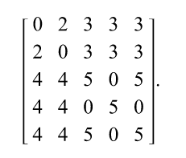

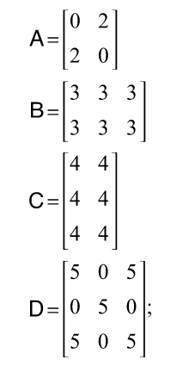
Block matrix
Corresponding substitution relationship:
Y1 = A1 + B1
Y2 = A2 + B2
Y3 = C1 + D1
…
A1 = 0 X1 + 2 X2
B1 = 3 X1 + 3 X2 + 3 X3
A2 = 2 X1 + 0 X2
…

Slide 10
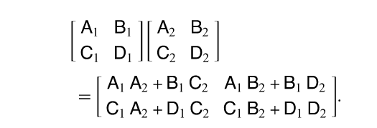
Block matrix multiplication
In short, if we treat the matrix (linear map) itself as an object and as an element of another matrix, then the properties of the latter with respect to the matrix will be preserved entirely!
* It has now been verified that putting real numbers, complex numbers, and matrices into the matrix as objects does not destroy its properties. But not any object is OK, such as natural numbers, positive real numbers. So how to check it? This problem needs to be studied in a more advanced mathematics course (abstract algebra). Matrix ring - Wikipedia

Slide 11
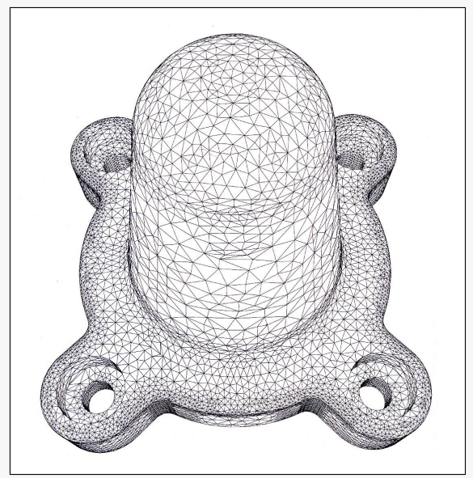
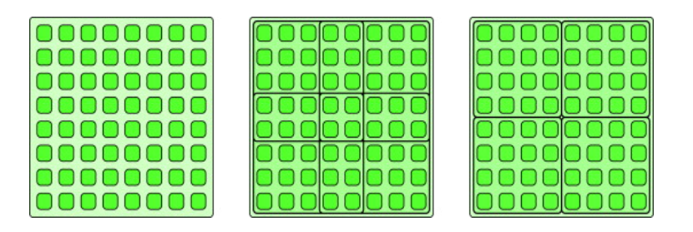
Parallelization Models
geometric-decomposition
Features:
  Based on the intrinsic topology of the data, it is segmented and assigned to different compute nodes
  Each node performs all calculations involving the data it owns
  The communication process is predictable and is not affected by the calculation process
2-D Grid
Irregular Mesh

Slide 12
Simple Parallel Algorithm
1st horizontal Broadcast
A11 | A12 | A13
A21 | A22 | A23
A31 | A32 | A33
Stages:
  Store blocks A _{i,j}, B_{i,j} on the corresponding nodes
  Each node broadcasts its own A_{i,j}, B_{i,j} along the horizontal and vertical axes; After the broadcast, each node has all blocks of data in the same column and row
    Step 1

Slide 13
Simple Parallel Algorithm
2nd horizontal Broadcast
A11 | A12 | A13
A21 | A22 | A23
A31 | A32 | A33
Stages:
  Each node broadcasts its own A_{i,j}, B_{i,j} along the horizontal and vertical axes; After the broadcast, each node has all blocks of data in the same column and row
    Step 2

Slide 14
Simple Parallel Algorithm
3rd horizontal Broadcast
A11 | A12 | A13
A21 | A22 | A23
A31 | A32 | A33
Stages:
  Each node broadcasts its own A_{i,j}, B_{i,j} along the horizontal and vertical axes; After the broadcast, each node has all blocks of data in the same column and row
    Step 3

Slide 15
Simple Parallel Algorithm
1st vertical Broadcast
B11 | B12 | B13
B21 | B22 | B23
B31 | B32 | B33
Stages:
  Each node broadcasts its own A_{i,j}, B_{i,j} along the horizontal and vertical axes; After the broadcast, each node has all blocks of data in the same column and row
    Step 4

Slide 16
Simple Parallel Algorithm
2nd vertical Broadcast
B11 | B12 | B13
B21 | B22 | B23
B31 | B32 | B33
Stages:
  Each node broadcasts its own A_{i,j}, B_{i,j} along the horizontal and vertical axes; After the broadcast, each node has all blocks of data in the same column and row
    Step 5

Slide 17
Simple Parallel Algorithm
3rd vertical Broadcast
B11 | B12 | B13
B21 | B22 | B23
B31 | B32 | B33
Stages:
  Each node broadcasts its own A_{i,j}, B_{i,j} along the horizontal and vertical axes; After the broadcast, each node has all blocks of data in the same column and row
    Step 6

Slide 18
Simple Parallel Algorithm
C11 needs these…
A11 | A12 | A13
A21 | A22 | A23
A31 | A32 | A33
C11 needs these…
B11 | B12 | B13
B21 | B22 | B23
B31 | B32 | B33
Stages：
  Each node calculates C_ {i,j}, for example
    C11 = A11 B11 + A12 B21 + A13 B31

Slide 19
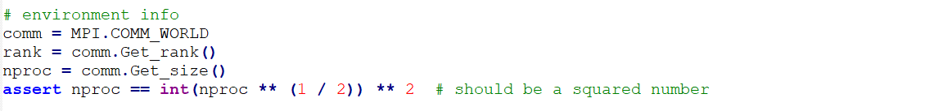
code
Get the MPI environment
  Note that the number of processes must be squared

Slide 20
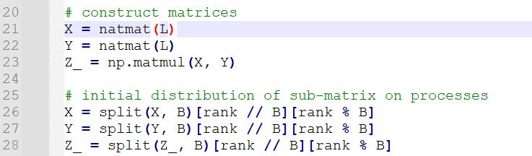
code
Generate data
  Initially, all nodes generate data, but only intercept what they need to keep
  Note: In practice, input data is distributed from node 0 at first, but here it is simplified for practice

Slide 21
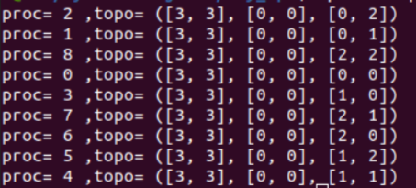
Process topology
The above code defines a Cartesian process topology that does the following:
  Two-dimensional coordinates are provided to facilitate positioning processes
0 (0,0) | 1 (0,1) | 2 (0,2)
3 (1,0) | 4 (1,1) | 5 (1,2)
6 (2,0) | 7 (2,1) | 8 (2,2)
topo = (size of grid, periodic, coordinates)
Explain later

Slide 22
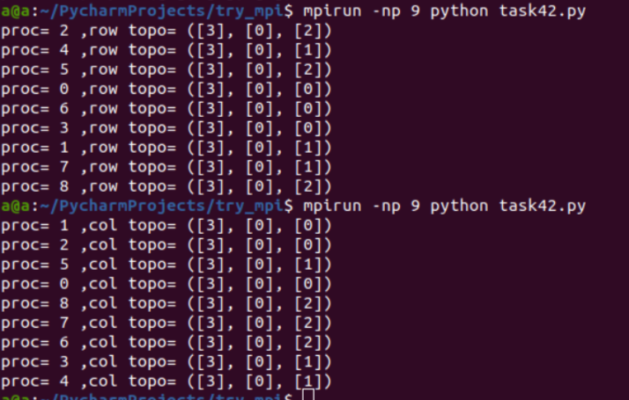
Process topology
  Turn the grid into lower-dimensional subgrids
0 (0) | 1 (1) | 2 (2)
3 (0) | 4 (1) | 5 (2)
6 (0) | 7 (1) | 8 (2)
0 (0) | 1 (0) | 2 (0)
3 (1) | 4 (1) | 5 (1)
6 (2) | 7 (2) | 8 (2)
row_comm: Only the second coordinate is retained
col_comm: Only the first coordinate is retained
topo = (size of grid, periodic, coordinates)
Explain later

Slide 23

Process topology
  Each grid has a communicator object associated with it, which can be used for local broadcasting. For example
  It sends X horizontally from all nodes with coordinates i to other nodes
1st horizontal Broadcast
0 (0) | 1 (1) | 2 (2)
3 (0) | 4 (1) | 5 (2)
6 (0) | 7 (1) | 8 (2)

Slide 24
Process topology
Finally, if I don't use bcast, I'll use point-to-point sending, okay?
Of course. For example, in the figure above, we can call send/recv six times to complete the data transfer. (If you write this in Lab 4, you can get part of points)
But the point is, if you define topology explicitly, the MPI library has the potential to automatically match your processes to the most suitable location in the hardware network! Otherwise, the MPI library can only be mapped randomly, which affects performance!
1st horizontal Broadcast
0 (0) | 1 (1) | 2 (2)
3 (0) | 4 (1) | 5 (2)
6 (0) | 7 (1) | 8 (2)
These network topologies are especially suitable for matrix operations!

Slide 25
Cannon’s algorithm
For the simple algorithm introduced earlier, one of its drawbacks is that it takes up too much storage space. That is, each node stores all the blocks of data in the same row and column. To improve this, consider alternating transmission and computation. This is Cannon's algorithm.
Steps：
  1. Distribute, this is the same as before
  2. Rearrange
0 | 1 | 2 | 3
4 | 5 | 6 | 7
8 | 9 | 10 | 11
12 | 13 | 14 | 15
0 | 1 | 2 | 3
4 | 5 | 6 | 7
8 | 9 | 10 | 11
12 | 13 | 14 | 15
X
Y

Slide 26
  Rearrange
Dim 1
0 | 1 | 2 | 3
5 | 6 | 7 | 4
9 | 10 | 11 | 8
13 | 14 | 15 | 12
0 | 1 | 2 | 3
5 | 6 | 7 | 4
10 | 11 | 8 | 9
14 | 15 | 12 | 13
X
X
Dim 2
0 | 1 | 2 | 3
5 | 6 | 7 | 4
10 | 11 | 8 | 9
15 | 12 | 13 | 14
X
  First rearrange X horizontally: cyclically rotate to left by times equaling to dim 2

Slide 27
  Rearrange
Dim 1
0 | 5 | 6 | 7
4 | 9 | 10 | 11
8 | 13 | 14 | 15
12 | 1 | 2 | 3
0 | 5 | 10 | 11
4 | 9 | 14 | 15
8 | 13 | 2 | 3
12 | 1 | 6 | 7
Y
Y
Dim 2
0 | 5 | 10 | 15
4 | 9 | 14 | 3
8 | 13 | 2 | 7
12 | 1 | 6 | 11
Y
  then rearrange X vertically: cyclically rotate to up by times equaling to dim 1

Slide 28
compute
0 | 1 | 2 | 3
5 | 6 | 7 | 4
10 | 11 | 8 | 9
15 | 12 | 13 | 14
0 | 5 | 10 | 15
4 | 9 | 14 | 3
8 | 13 | 2 | 7
12 | 1 | 6 | 11
X
Y
0 | 1 | 2 | 3
4 | 5 | 6 | 7
8 | 9 | 10 | 11
12 | 13 | 14 | 15
Z
Multiply the data X and Y owned by this node
They happen to be part of Z=XY, e.g.
    Z0 = X0 Y0 + X1 Y4 + X2 Y8 + X3 Y12
    Z5 = X4 Y1 + X5 Y5 + X6 Y9 + X7 Y13
    Z14 = X12 Y2 + X13 Y6 + X14 Y10 + X15 Y14

Slide 29
Rotate as a whole
1 | 2 | 3 | 0
6 | 7 | 4 | 5
11 | 8 | 9 | 10
12 | 13 | 14 | 15
4 | 9 | 14 | 3
8 | 13 | 2 | 7
12 | 1 | 6 | 11
0 | 5 | 10 | 15
X
Y
Rotate to the left for X as a whole and upward for Y as a whole

Slide 30
compute
1 | 2 | 3 | 0
6 | 7 | 4 | 5
11 | 8 | 9 | 10
12 | 13 | 14 | 15
4 | 9 | 14 | 3
8 | 13 | 2 | 7
12 | 1 | 6 | 11
0 | 5 | 10 | 15
X
Y
0 | 1 | 2 | 3
4 | 5 | 6 | 7
8 | 9 | 10 | 11
12 | 13 | 14 | 15
Z
  They happen to be another part of Z=XY, e.g.
  Z0 = X0 Y0 + X1 Y4 + X2 Y8 + X3 Y12
    Z5 = X4 Y1 + X5 Y5 + X6 Y9 + X7 Y13
    Z14 = X12 Y2 + X13 Y6 + X14 Y10 + X15 Y14

Slide 31
iterate
Repeat the calculation + rotate process B times, and the data retained by each node at the end is what we want

Slide 32
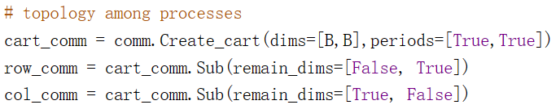

code
The rotation operations used here are directly supported in MPI. It requires: 1) define a looping topolopy,
2) Use the shift method to query the source and destination of the data stored in the rotation of this node
For example, for node 5, for X (horizontal), it needs to send to 4 and receive 6; For Y (vertical), it needs to go to 1 and receive 9
0 | 1 | 2 | 3
4 | 5 | 6 | 7
8 | 9 | 10 | 11
12 | 13 | 14 | 15

Slide 33
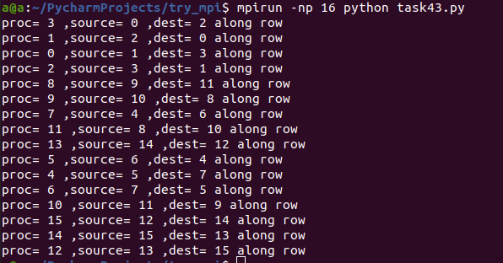
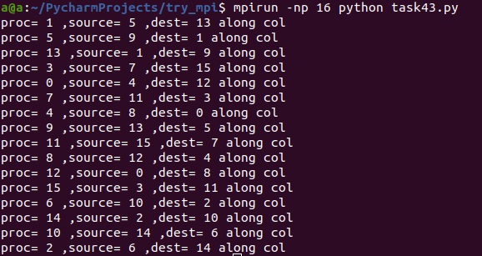
Sample output

Slide 34
code
3) MPI relay communication: Trigger multiple transmit and receive processes simultaneously. This function not only makes the rotation operations simple, but also has the possibility of optimizing them with specific hardware.
*If the software-defined topology and hardware network match, the resources will be fully utilized!
2-D wraparound grid

Slide 35
DNS algorithm
Simple and Connon‘s algorithms, using O(N^2) processors - can it be faster?
Yes! With O(N^3) processors, The program can be further accelerated. The basic idea is to use nodes to process intermediate data (has N^3), not inputs or outputs (only N^2).
Steps:
  First of all, put the data to the 0~N^2-1 node, which is the same as before
0 | 1 | 2
3 | 4 | 5
6 | 7 | 8
0 | 1 | 2
3 | 4 | 5
6 | 7 | 8
X
Y
Notes:
can reduce the O(N^3) complexity of matrix multiplication to O(N)

Slide 36
Propagation
1) Send different columns of A and different rows of B to different planes
 |  | 2
 |  | 5
 |  | 8
6 | 7 | 8
 | 1
 | 4
 | 7
3 | 4 | 5
0
3
6
0 | 1 | 2
X
Y

Slide 37
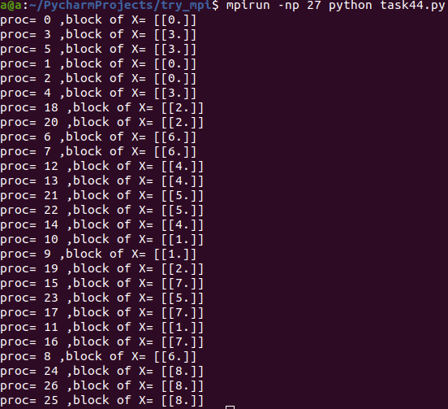
Propagation
2) On every planes, broadcast existing data
2 | 2 | 2
5 | 5 | 5
8 | 8 | 8
6 | 7 | 8
6 | 7 | 8
6 | 7 | 8
1 | 1 | 1
4 | 4 | 4
7 | 7 | 7
3 | 4 | 5
3 | 4 | 5
3 | 4 | 5
0 | 0 | 0
3 | 3 | 3
6 | 6 | 6
0 | 1 | 2
0 | 1 | 2
0 | 1 | 2
X
Y

Slide 38
multiplication
2 | 2 | 2
5 | 5 | 5
8 | 8 | 8
6 | 7 | 8
6 | 7 | 8
6 | 7 | 8
1 | 1 | 1
4 | 4 | 4
7 | 7 | 7
3 | 4 | 5
3 | 4 | 5
3 | 4 | 5
0 | 0 | 0
3 | 3 | 3
6 | 6 | 6
0 | 1 | 2
0 | 1 | 2
0 | 1 | 2
0 | 1 | 2
3 | 4 | 5
6 | 7 | 8
X
Y
Z
At this time, in each node, there are exactly the data blocks required for each multiplication, a total of which is N^3. Multiply it!
    Z1 = X0 Y1 + X1 Y4 + X2 Y7
    Z5 = X3 Y2 + X4 Y5 + X5 Y8
    Z6 = X6 Y0 + X7 Y3 + X8 Y6

Slide 39
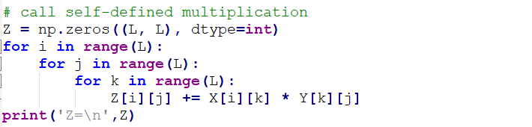
Reduction
3）For results on different planes, perform reduction (sum) operations. In plane 0, that is, what we want.
*Understand this algorithm from a coder’s perspective: 1) Loop unfolding. If we rewrite
as
    for i in range(N**3): ….(omit)…
2）Parallel execution. For unrelated loops, a parallel step can be done.
3）Reduction. A O(logN) step is required (explained later).

Slide 40
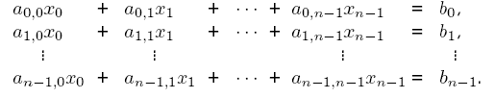
Solving a System of Linear Equations
Consider the problem of solving linear equations of the kind:
This is written as Ax = b, where A is an n x n matrix with A[i, j] = a_{i,j}, b is an n x 1 vector [ b₀, b₁, … , b_{n} ]^{T}, and x is the solution.

Slide 41
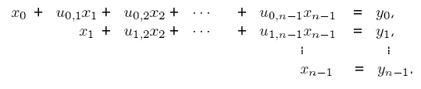
Solving a System of Linear Equations
Two steps in solution are: reduction to triangular form, and back-substitution. The triangular form is as:
We write this as: Ux = y .
A commonly used method for transforming a given matrix into an upper-triangular matrix is Gaussian Elimination.

Slide 42
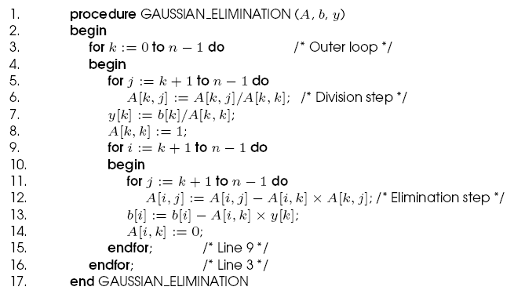
Gaussian Elimination
Serial Gaussian Elimination

Slide 43
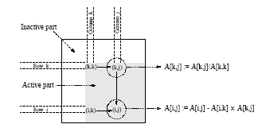
Gaussian Elimination
The computation has three nested loops - in the kth iteration of the outer loop, the algorithm performs (n-k)² computations. Summing from k = 1..n, we have roughly (n³/3) multiplications-subtractions.
A typical computation in Gaussian elimination.

Slide 44


Parallel Gaussian Elimination
Assume p = n with each row assigned to a processor.
The first step of the algorithm normalizes the row. This is a serial operation and takes time (n-k) in the kth iteration.
In the second step, the normalized row is broadcast to all the processors. This takes time .
Each processor can independently eliminate this row from its own. This requires (n-k-1) multiplications and subtractions.
The total parallel time can be computed by summing from k = 1 … n-1 as
The formulation is not cost optimal because of the t_{w} term.

Slide 45
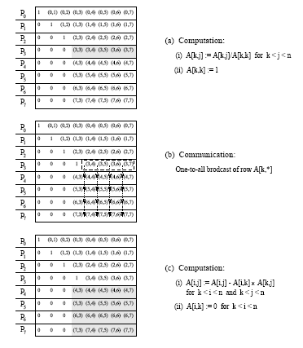
Parallel Gaussian Elimination
Gaussian elimination steps during the iteration corresponding k = 3 for an 8 x 8 matrix partitioned rowwise among eight processes.

Slide 46
Parallel Gaussian Elimination:
Pipelined Execution
In the previous formulation, the (k+1)st iteration starts only after all the computation and communication for the kth iteration is complete.
In the pipelined version, there are three steps - normalization of a row, communication, and elimination. These steps are performed in an asynchronous fashion.
A processor P_{k} waits to receive and eliminate all rows prior to k.
Once it has done this, it forwards its own row to processor Pk+1.

Slide 47
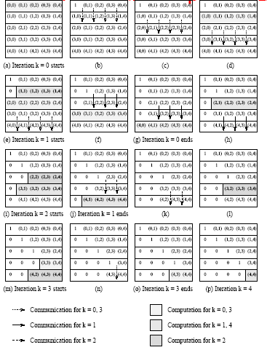
Parallel Gaussian Elimination:
Pipelined Execution
Pipelined Gaussian elimination on a 5 x 5 matrix partitioned withone row per process.

Slide 48
Parallel Gaussian Elimination:
Pipelined Execution
The total number of steps in the entire pipelined procedure is Θ(n).
In any step, either O(n) elements are communicated between directly-connected processes, or a division step is performed on O(n) elements of a row, or an elimination step is performed on O(n) elements of a row.
The parallel time is therefore O(n²) .
This is cost optimal.

Slide 49
Parallel Gaussian Elimination:
Pipelined Execution
The communication in the Gaussian elimination iteration
corresponding to k = 3 for an 8 x 8 matrix distributed among four processes using block 1-D partitioning.

Slide 50

Parallel Gaussian Elimination:
Block 1D with p < n
The above algorithm can be easily adapted to the case when p < n.
In the kth iteration, a processor with all rows belonging to the active part of the matrix performs (n – k -1) / np multiplications and subtractions.
In the pipelined version, for n > p, computation dominates communication.
The parallel time is given by:
or approximately, n³/p.
While the algorithm is cost optimal, the cost of the parallel algorithm is higher than the sequential run time by a factor of 3/2.

Slide 51
Parallel Gaussian Elimination:
Block 1D with p < n
Computation load on different processes in block and cyclic
1-D partitioning of an 8 x 8 matrix on four processes during the
Gaussian elimination iteration corresponding to k = 3.

Slide 52
Parallel Gaussian Elimination:
Block 1D with p < n
The load imbalance problem can be alleviated by using a cyclic mapping.
In this case, other than processing of the last p rows, there is no load imbalance.
This corresponds to a cumulative load imbalance overhead of O(n²p) (instead of O(n³) in the previous case).

Slide 53
Parallel Gaussian Elimination:
2-D Mapping
Assume an n x n matrix A mapped onto an n x n mesh of processors.
Each update of the partial matrix can be thought of as a scaled rank-one update (scaling by the pivot element).
In the first step, the pivot is broadcast to the row of processors.
In the second step, each processor locally updates its value. For this it needs the corresponding value from the pivot row, and the scaling value from its own row.
This requires two broadcasts, each of which takes log n time.
This results in a non-cost-optimal algorithm.

Slide 54
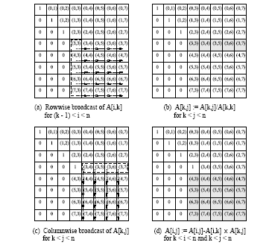
Parallel Gaussian Elimination:
2-D Mapping
Various steps in the Gaussian elimination iteration corresponding to k = 3 for an 8 x 8 matrix on 64 processes arranged in a logical two-dimensional mesh.

Slide 55
Parallel Gaussian Elimination:
2-D Mapping with Pipelining
We pipeline along two dimensions. First, the pivot value is pipelined along the row. Then the scaled pivot row is pipelined down.
Processor P_{i,j} (not on the pivot row) performs the elimination step A[i, j] := A[i, j]] - A[i, k] A[k, j] as soon as A[i, k] and A[k, j] are available.
The computation and communication for each iteration moves through the mesh from top-left to bottom-right as a ``front.''
After the front corresponding to a certain iteration passes through a process, the process is free to perform subsequent iterations.
Multiple fronts that correspond to different iterations are active simultaneously.

Slide 56
Parallel Gaussian Elimination:
2-D Mapping with Pipelining
If each step (division, elimination, or communication) is assumed to take constant time, the front moves a single step in this time. The front takes Θ(n) time to reach P_{n-1,n-1}.
Once the front has progressed past a diagonal processor, the next front can be initiated. In this way, the last front passes the bottom-right corner of the matrix Θ(n) steps after the first one.
The parallel time is therefore O(n) , which is cost-optimal.

Slide 57
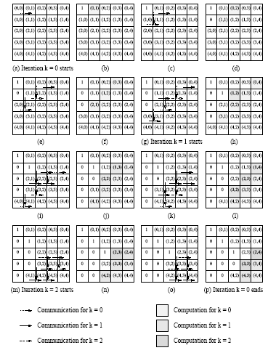
2-D Mapping with Pipelining
Pipelined Gaussian elimination for a 5 x 5 matrix with 25 processors.

Slide 58

Parallel Gaussian Elimination:
2-D Mapping with Pipelining and p < n
In this case, a processor containing a completely active part of the matrix performs n²/p multiplications and subtractions, and communicates words along its row and its column.
The computation dominates communication for n >> p.
The total parallel run time of this algorithm is (2n²/p) x n, since there are n iterations. This is equal to 2n³/p.
This is three times the serial operation count!

Slide 59
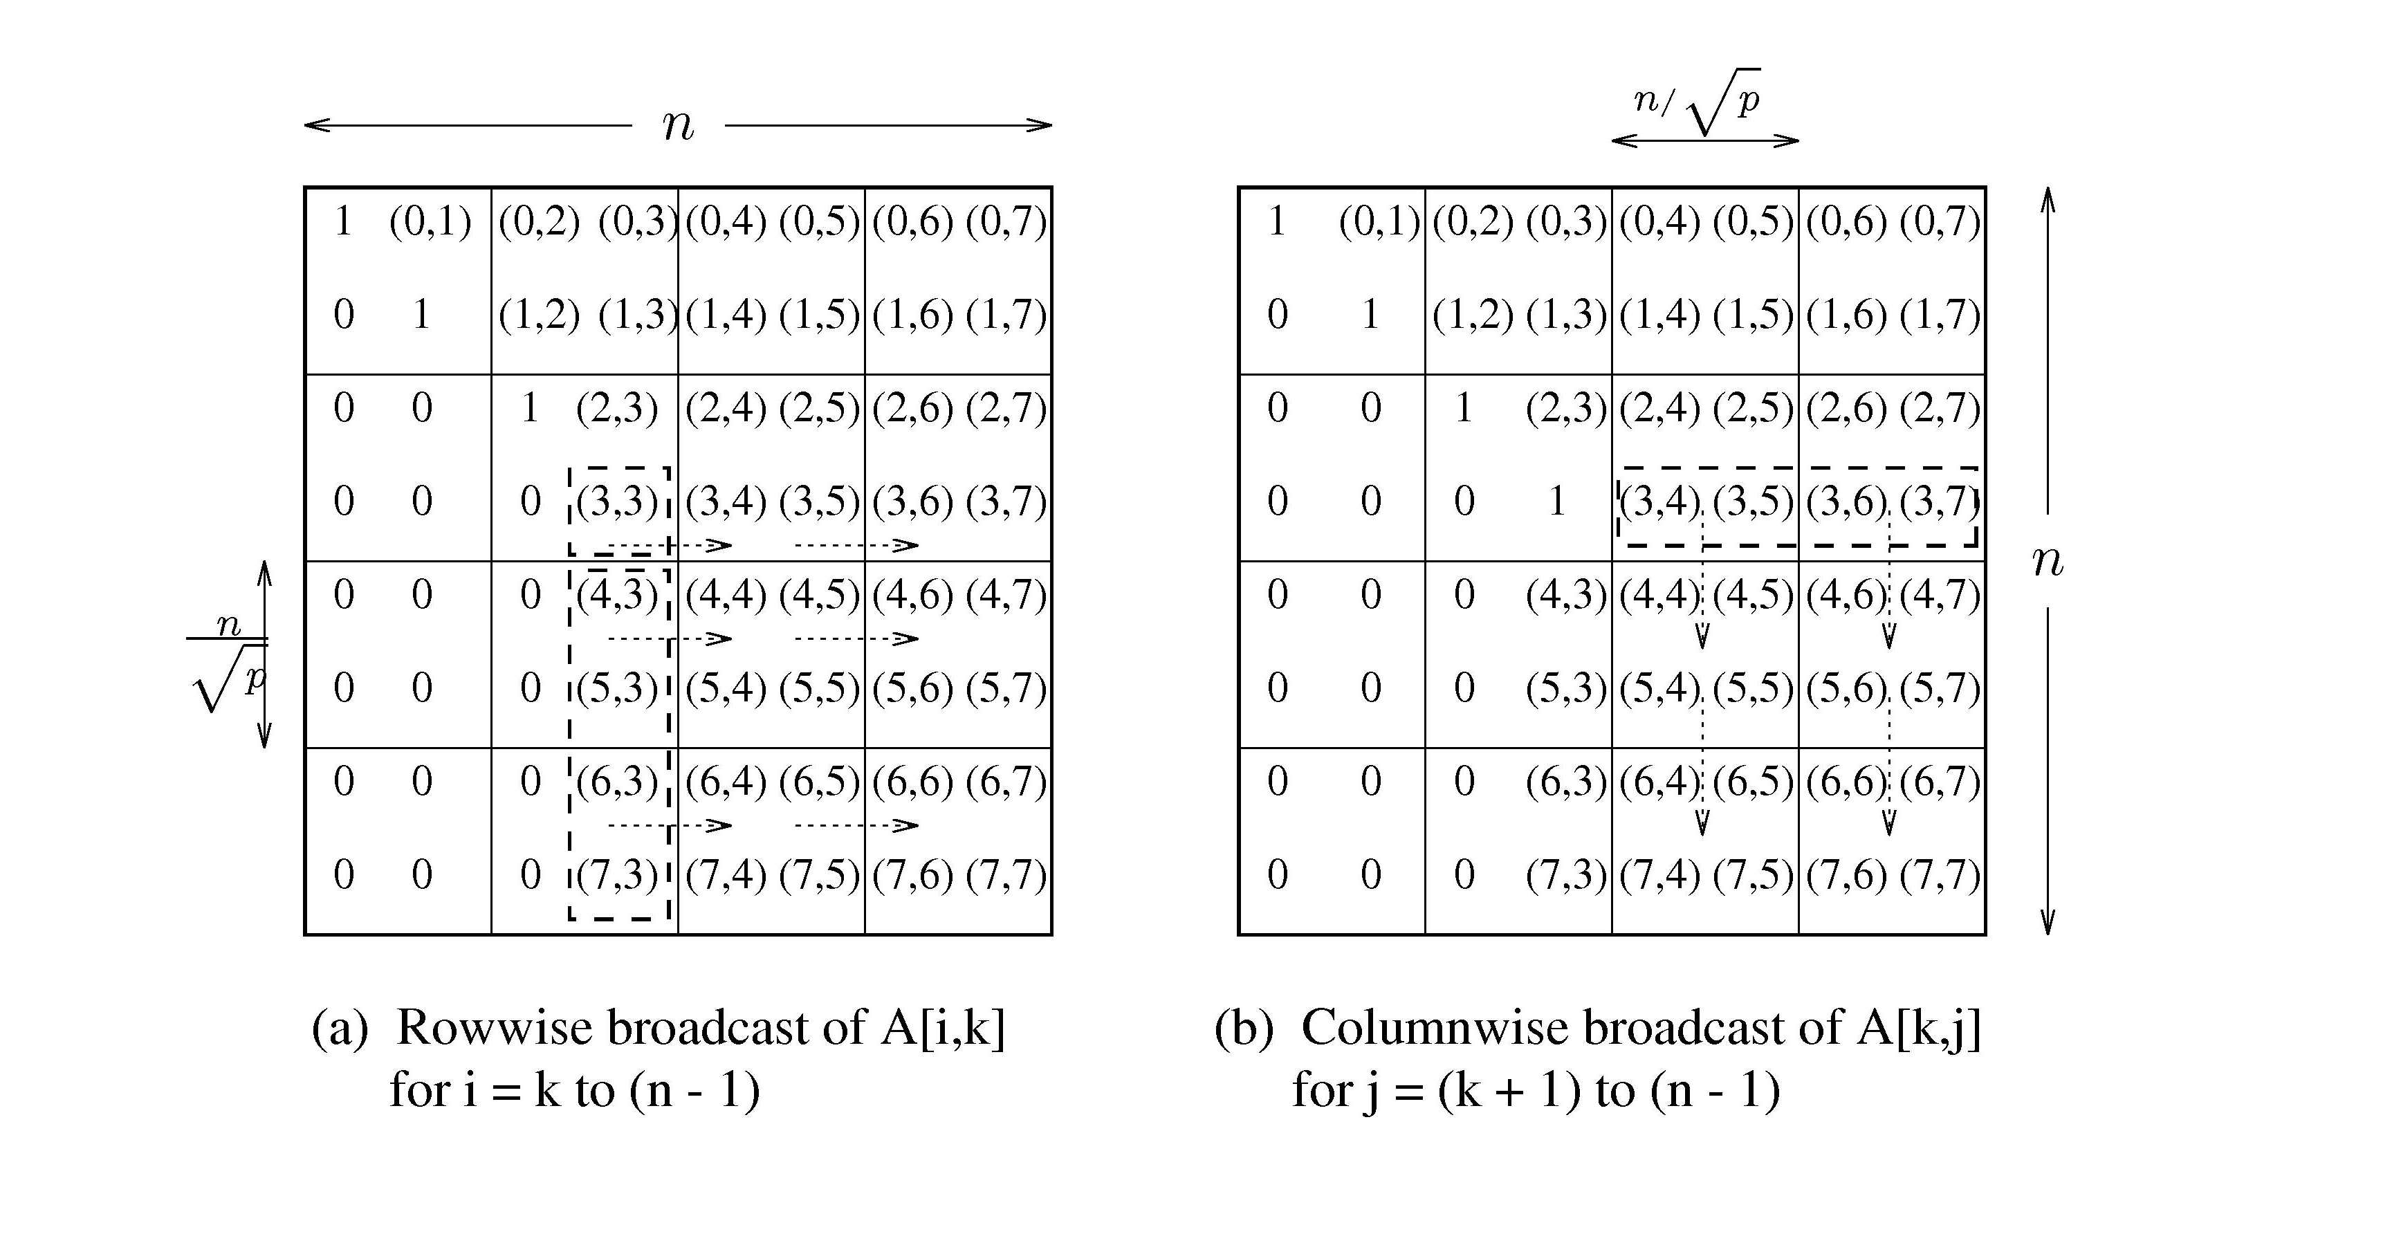
Parallel Gaussian Elimination:
2-D Mapping with Pipelining and p < n
The communication steps in the Gaussian elimination iteration corresponding to k = 3 for an 8 x 8 matrix on 16 processes of a two-dimensional mesh.

Slide 60
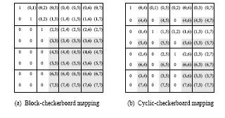
Parallel Gaussian Elimination:
2-D Mapping with Pipelining and p < n
Computational load on different processes in block and cyclic
2-D mappings of an 8 x 8 matrix onto 16 processes during the Gaussian elimination iteration corresponding to k = 3.

Slide 61


Parallel Gaussian Elimination:
2-D Cyclic Mapping
The idling in the block mapping can be alleviated using a cyclic mapping.
The maximum difference in computational load between any two processes in any iteration is that of one row and one column update.
This contributes to the overhead function. Since there are n iterations, the total overhead is .

Slide 62
Gaussian Elimination with Partial Pivoting
For numerical stability, one generally uses partial pivoting.
In the k th iteration, we select a column i (called the pivot column) such that A[k, i] is the largest in magnitude among all A[k, i] such that k ≤ j < n.
The k th and the i th columns are interchanged.
Simple to implement with row-partitioning and does not add overhead since the division step takes the same time as computing the max.
Column-partitioning, however, requires a global reduction, adding a log p term to the overhead.
Pivoting precludes the use of pipelining.

Slide 63
Gaussian Elimination with Partial Pivoting: 2-D Partitioning
Partial pivoting restricts use of pipelining, resulting in performance loss.
This loss can be alleviated by restricting pivoting to specific columns.
Alternately, we can use faster algorithms for broadcast.

Slide 64
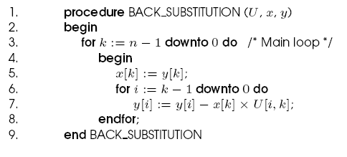
Solving a Triangular System:
Back-Substitution
The upper triangular matrix U undergoes back-substitution to determine the vector x.
A serial algorithm for back-substitution.

Slide 65
Solving a Triangular System:
Back-Substitution
The algorithm performs approximately n²/2 multiplications and subtractions.
Since complexity of this part is asymptotically lower, we should optimize the data distribution for the factorization part.
Consider a rowwise block 1-D mapping of the n x n matrix U with vector y distributed uniformly.
The value of the variable solved at a step can be pipelined back.
Each step of a pipelined implementation requires a constant amount of time for communication and Θ(n/p) time for computation.
The parallel run time of the entire algorithm is Θ(n²/p).

Slide 66



Solving a Triangular System:
Back-Substitution
If the matrix is partitioned by using 2-D partitioning on a logical mesh of processes, and the elements of the vector are distributed along one of the columns of the process mesh, then only the processes containing the vector perform any computation.
Using pipelining to communicate the appropriate elements of U to the process containing the corresponding elements of y for the substitution step (line 7), the algorithm can be executed in time.
While this is not cost optimal, since this does not dominate the overall computation, the cost optimality is determined by the factorization.

